Slide 1


Slide 2
Nā tō rourou, nā taku rourou ka ora ai te iwi.
With your food basket and my food basket the people will thrive.
Facilitation Workshop – 8 April 2022, Ian Stevens

Slide 3
Being a Facilitator
Facilitation Workshop – 8 April 2022, Ian Stevens

Slide 4
Being a Facilitator
1. What are we trying to do?
2. Who are we doing it with?
3. How are we doing it?
4. What do we do?
5. When are we successful?
Facilitation Workshop – 8 April 2022, Ian Stevens

Slide 5
What are we trying to do? Why?
Facilitation Workshop – 8 April 2022, Ian Stevens

Slide 6
2. Who are we doing it with? What is their situation?
Facilitation Workshop – 8 April 2022, Ian Stevens

Slide 7
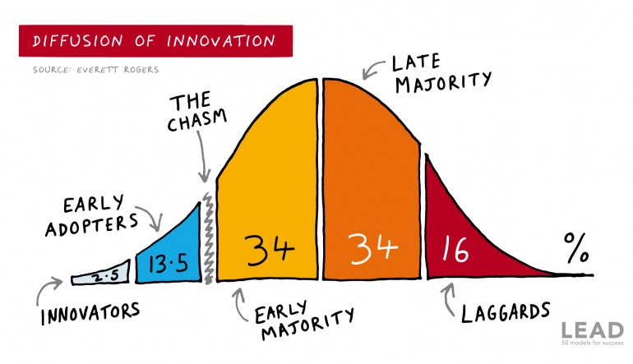
Learning Adventures New Zealand Facilitation Workshop – 8 April 2022, Ian Stevens

Slide 8
Simple Environments
Complex Environments
Facilitation Workshop – 8 April 2022, Ian Stevens

Slide 9
Simple - Stable environments
Environments that have a small number of external elements, elements are similar, and the elements remain the same or change slowly.
Complex - Unstable environments
Environments that have a large number of external elements, elements are dissimilar and where elements change frequently and unpredictably.
Facilitation Workshop – 8 April 2022, Ian Stevens

Slide 10
What do we do to deal with this variability?
Examples
Learning Adventures New Zealand Facilitation Workshop – 8 April 2022, Ian Stevens

Slide 11
3. How are we doing it? What is our approach?
Facilitation Workshop – 8 April 2022, Ian Stevens

Slide 12
Facilitating
- to make easier
- help bring about growth www.merriam-webster.com
- to make easier or less difficult
- help forward an action, a process, etc.
- assist the progress of a person www.dictionary.com
- the process of making something possible or easier
- the act of helping other people to deal with a process or
reach an agreement or solution without getting directly
involved in the process, discussion, etc. yourself
www.dictionary.cambridge.org
Learning Adventures New Zealand Facilitation Workshop – 8 April 2022, Ian Stevens

Slide 13
Organiser Advisor
Coach Consultant
Mentor Lecturer
Teacher Researcher
Counsellor Guide
Instructor Helper
Trainer Expert
Facilitation Workshop – 8 April 2022, Ian Stevens

Slide 14
Practical advise to become the worst facilitator ever
Facilitation Workshop – 8 April 2022, Ian Stevens

Slide 15
How are we doing it? What is our approach?
Facilitating
- help bring about growth
- assist the progress of a person
- the process of making something possible or easier
Simple Environments
Complex Environments
Learning Adventures New Zealand Facilitation Workshop – 8 April 2022, Ian Stevens

Slide 16
Routine expertise Adaptive expertise
Facilitation Workshop – 8 April 2022, Ian Stevens

Slide 17
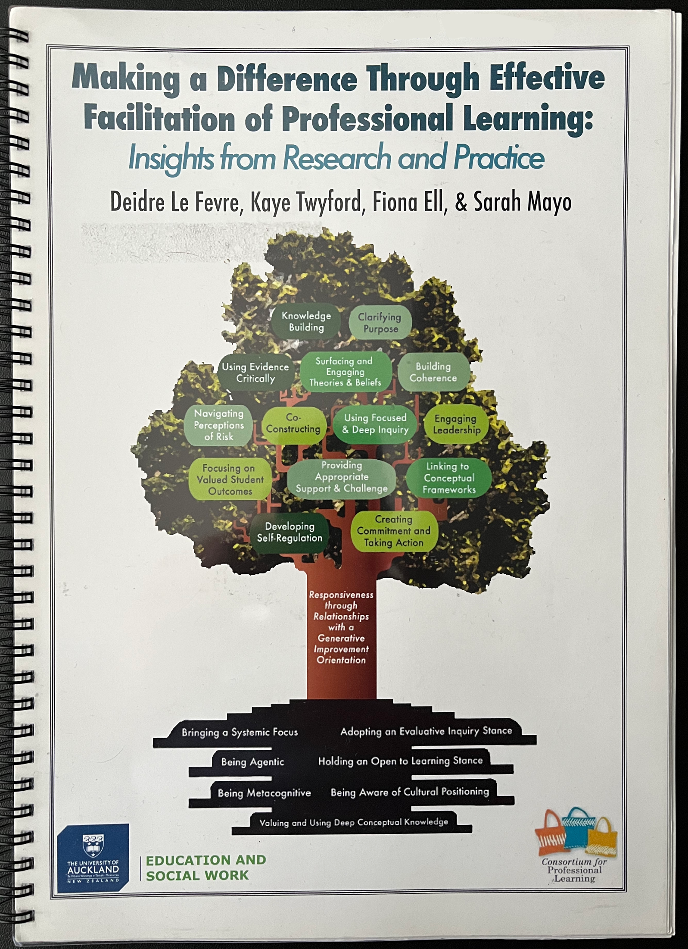
Facilitation Workshop – 8 April 2022, Ian Stevens

Slide 18
Routine expertise Adaptive expertise
Facilitation Workshop – 8 April 2022, Ian Stevens

Slide 19
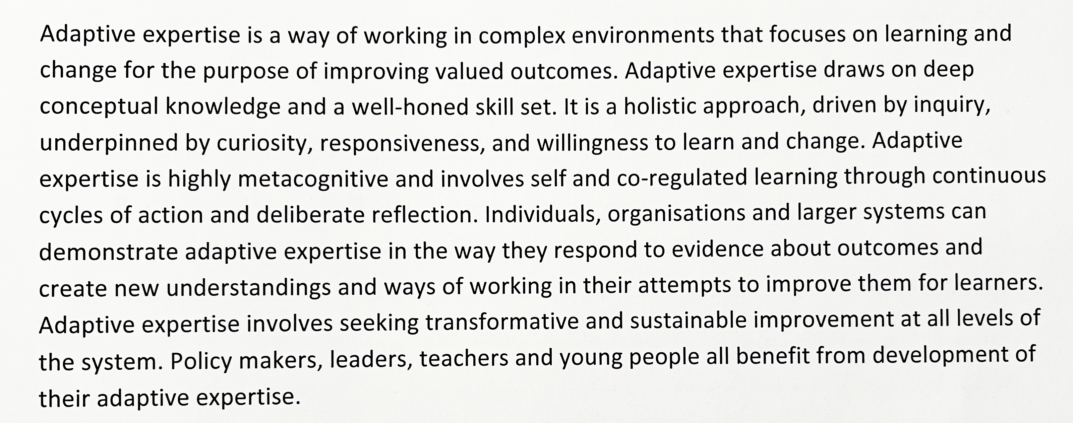
Adaptive expertise in facilitation
Learning Adventures New Zealand Facilitation Workshop – 8 April 2022, Ian Stevens

Slide 20
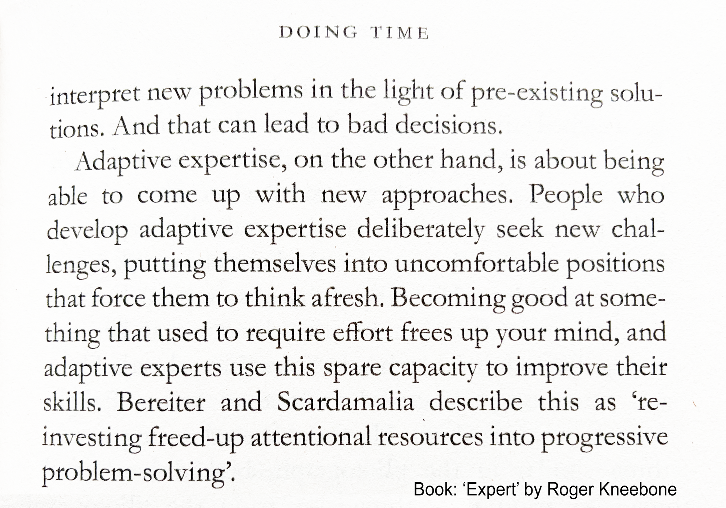
Novice
Expert
Learning Adventures New Zealand Facilitation Workshop – 8 April 2022, Ian Stevens

Slide 21
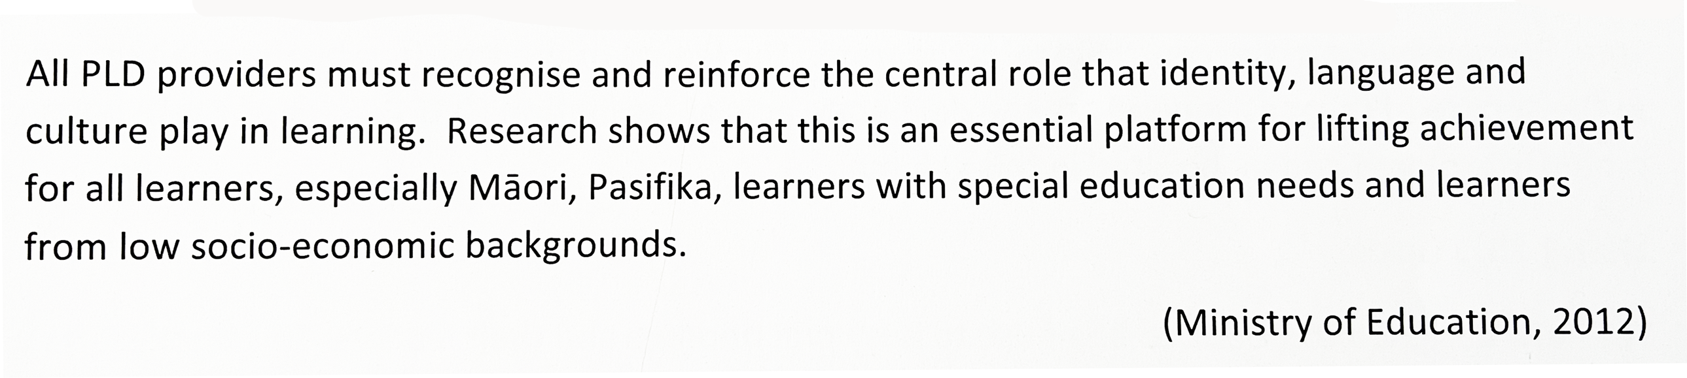
adaptive expertise
Linguistically and culturally responsive facilitation
- to ensure worthwhile outcome for all linguistically and culturally diverse learners
Facilitation Workshop – 8 April 2022, Ian Stevens

Slide 22
Facilitating
- help bring about growth
- assist the progress of a person
- the process of making something possible or easier
Changing Doing things differently
Facilitation Workshop – 8 April 2022, Ian Stevens

Slide 23
Learning Adventures New Zealand Facilitation Workshop – 8 April 2022, Ian Stevens

Slide 24
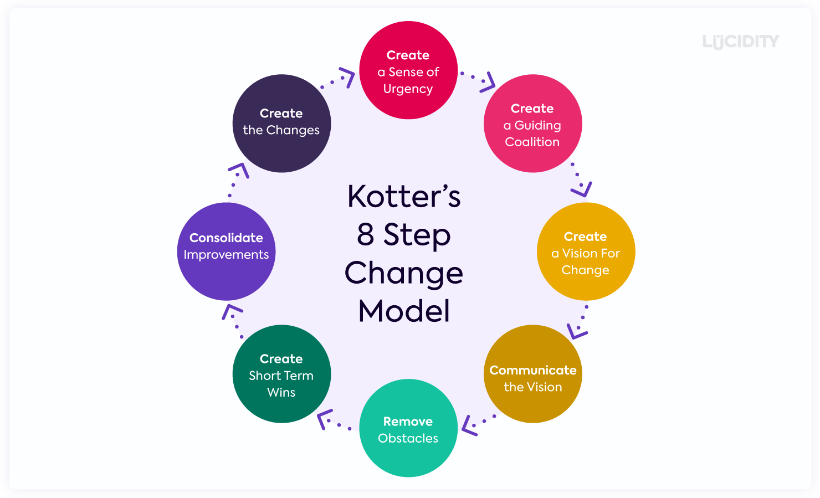
Learning Adventures New Zealand Facilitation Workshop – 8 April 2022, Ian Stevens

Slide 25
Facilitators lead the PLD in a school.
True or False?
Facilitation Workshop – 8 April 2022, Ian Stevens

Slide 26
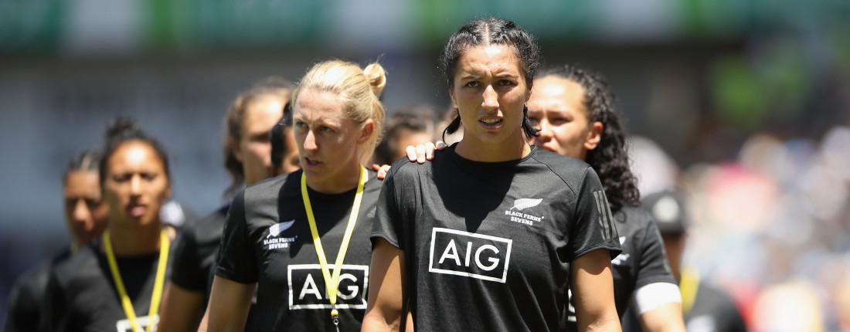
We leave ‘mana’ in our wake. Sarah Hirini
Facilitation Workshop – 8 April 2022, Ian Stevens
Notes:
Mana - prestige, authority, control, power, influence, status, spiritual power, charisma - mana is a supernatural force in a person, place or object. Mana goes hand in hand with tapu, one affecting the other. The more prestigious the event, person or object, the more it is surrounded by tapu and mana. www.maoridictionary.co.nz

Slide 27
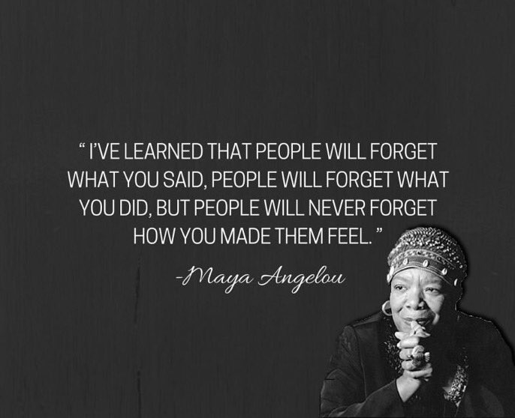
Facilitation Workshop – 8 April 2022, Ian Stevens

Slide 28
I build robust working relationships with my HOD, DP, teachers (probably in that order). Once a trusted relationship is forming, work can begin on what they want to do. It is not about what I want to do, it is about their ideas and actions.
Facilitation is a relationship job.
Jim Hogan
Facilitation Workshop – 8 April 2022, Ian Stevens

Slide 29
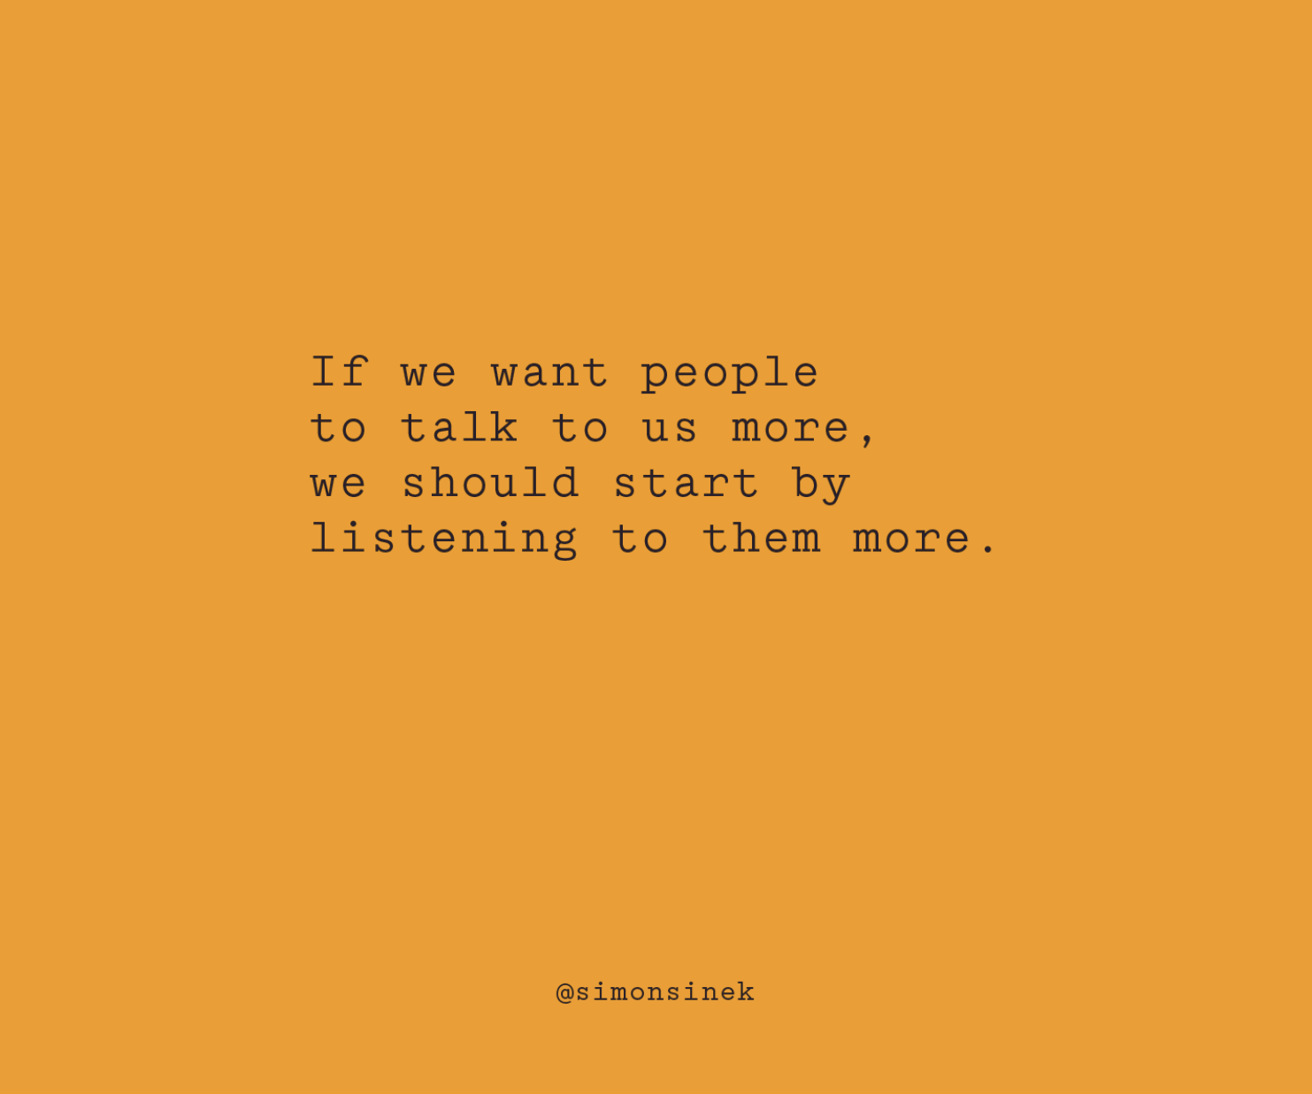
Facilitation Workshop – 8 April 2022, Ian Stevens

Slide 30
4. What do we do?
Facilitation Workshop – 8 April 2022, Ian Stevens

Slide 31
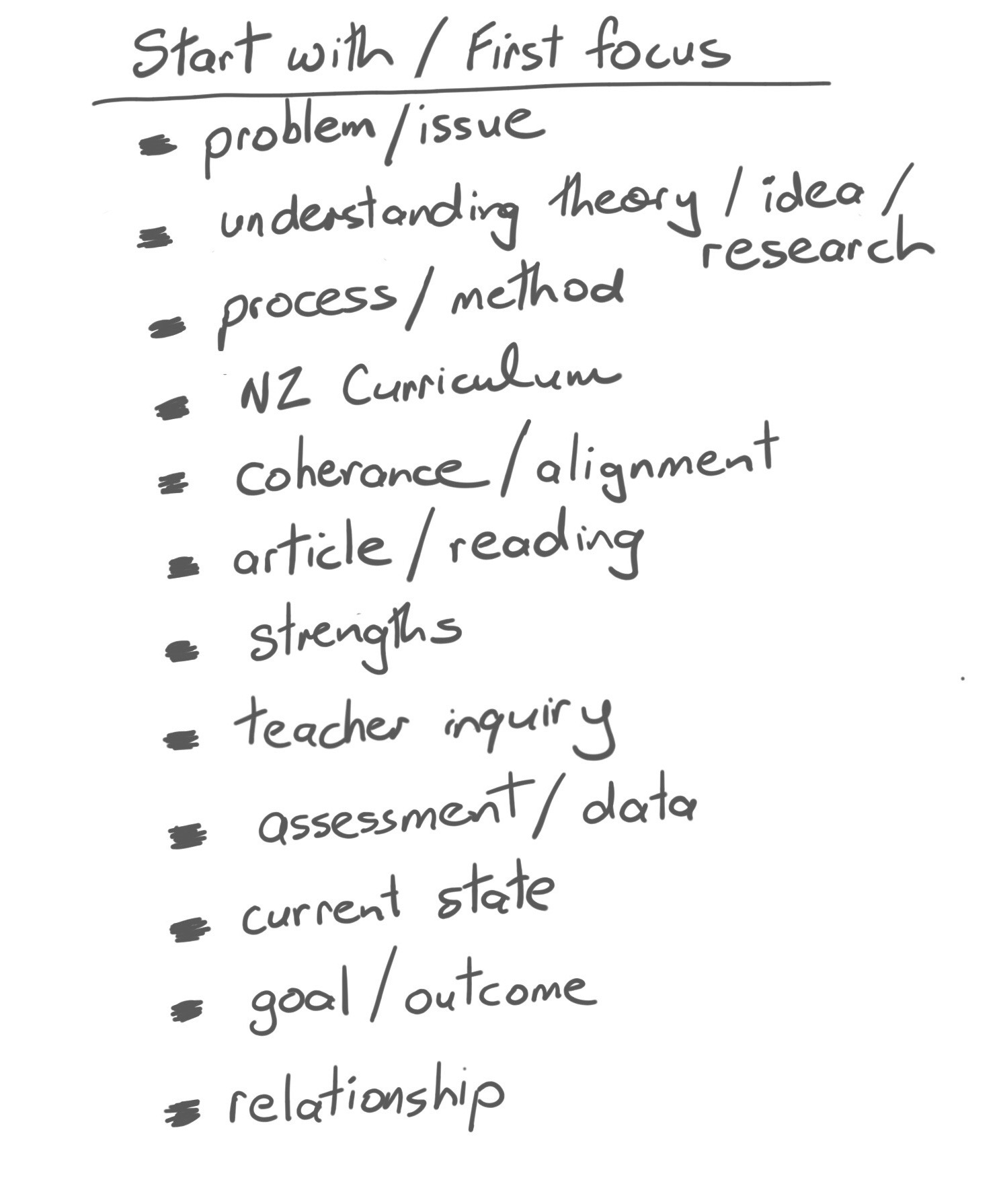
What is our
initial focus?
Facilitation Workshop – 8 April 2022, Ian Stevens
Notes:
I’ve just had the pleasure of talking to each of you, and here is some of the things you focus on and start with when beginning with a school.

Slide 32
Facilitation Workshop – 8 April 2022, Ian Stevens

Slide 33
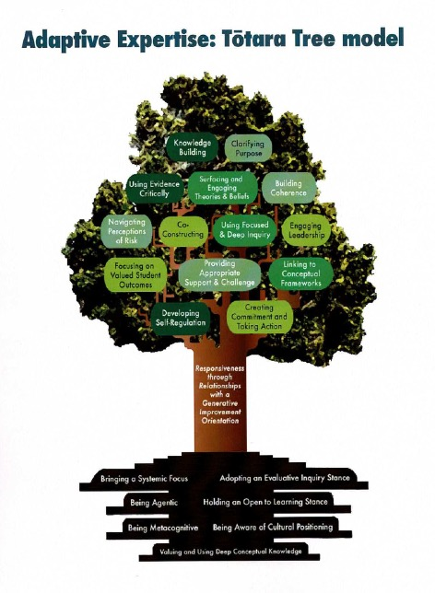
Facilitation Workshop – 8 April 2022, Ian Stevens

Slide 34
The giant Tōtara tree, a giant that protects surrounding trees, provides a way to explain the complex processes and interrelated connections involved
in facilitation as adaptive expertise.
Deliberate Acts of Facilitation
Responsiveness
Enablers
Facilitation Workshop – 8 April 2022, Ian Stevens

Slide 35
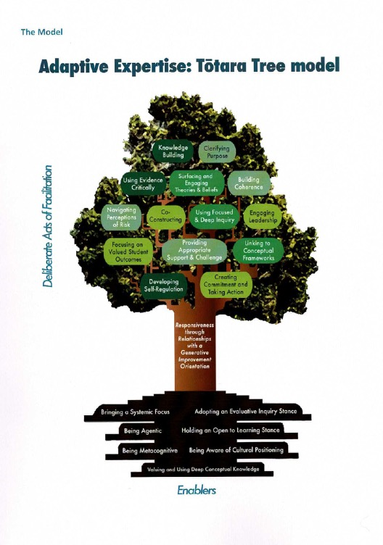
Deliberate Acts of Facilitation
1. Knowledge building
2. Clarifying purpose
3. Using evidence critically
4. Surfacing and engaging theories and beliefs
5. Building coherence
6. Navigating perceptions of risk
7. Co-constructing
8. Using focused and deep inquiry
9. Engaging leadership
10. Focusing on valued student outcomes
11. Providing appropriate support and
challenge
12. Linking to conceptual frameworks
13. Developing self-regulation
14. Creating commitment and taking action
Facilitation Workshop – 8 April 2022, Ian Stevens

Slide 36
Enablers
1. Bringing a systematic focus
2. Adopting an evaluative inquiry stance
3. Being agentic
4. Holding an open to learn stance
5. Being metacognitive
6. Being aware of cultural positioning
7. Valuing and using deep conceptual knowledge
Facilitation Workshop – 8 April 2022, Ian Stevens

Slide 37
The trunk represents facilitator responsiveness, driven by the intention to improve valued outcomes for learners through respectful
and trusted relationships.
Effective facilitation positions learners
at the centre and responds to their
individual differences and needs.
Facilitation Workshop – 8 April 2022, Ian Stevens

Slide 38
The “winning formula” was being able to choose the right thing at
the right time
Deliberate Acts of Facilitation
Responsiveness
Enablers
Facilitation Workshop – 8 April 2022, Ian Stevens

Slide 39
It was not just what they did, but who they were and how they did it that created impact. A metaphor to express this needed to show how the aspects of facilitation we had identified were not just a “tool kit” of equivalent elements but a dynamic, growing, interdependent system of actions, dispositions, and attitudes that together were powerful catalyst for change.
Facilitation Workshop – 8 April 2022, Ian Stevens

Slide 40
What do we do? Deliberate acts of facilitation Technique, activity, plan of action, tactic, task, strategy
Facilitation Workshop – 8 April 2022, Ian Stevens

Slide 41
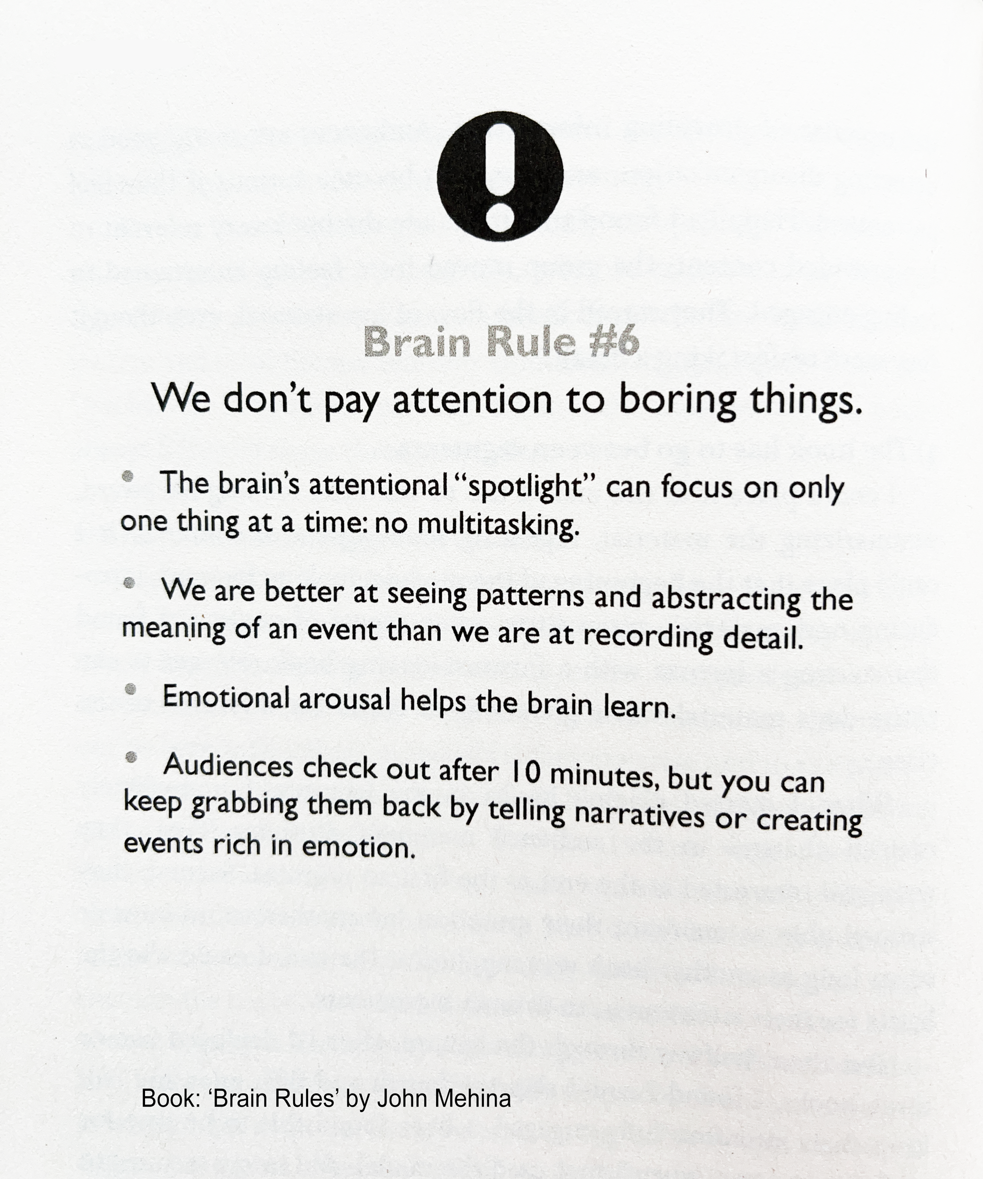
Facilitation Workshop – 8 April 2022, Ian Stevens

Slide 42
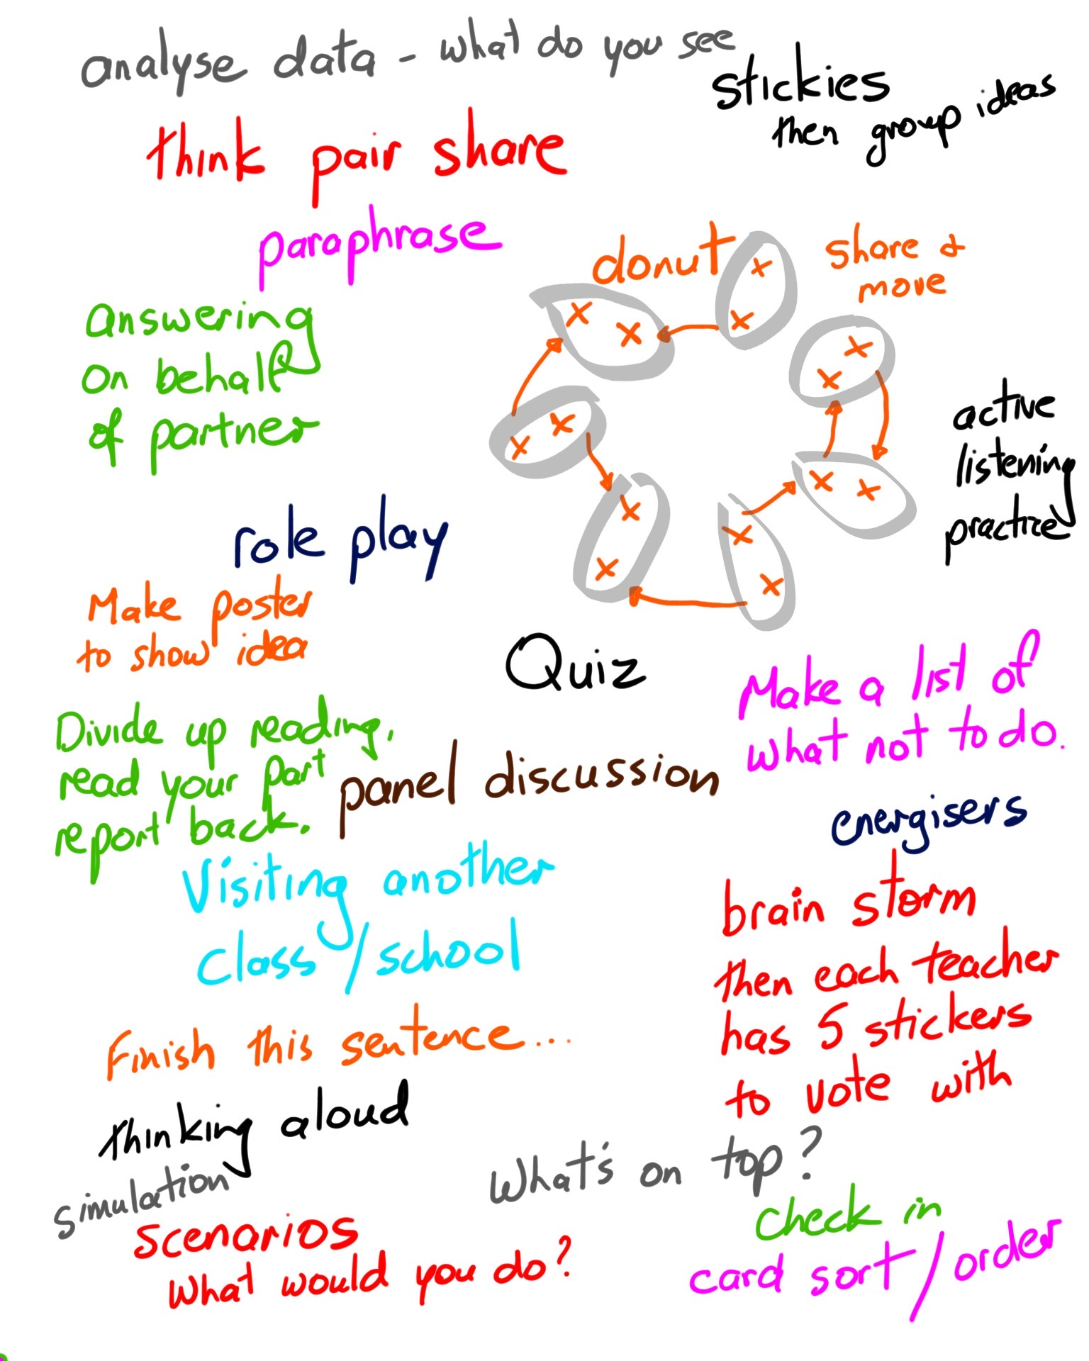
Facilitation Workshop – 8 April 2022, Ian Stevens

Slide 43
Scenarios
Facilitation Workshop – 8 April 2022, Ian Stevens

Slide 44
5. When are we successful?
Facilitation Workshop – 8 April 2022, Ian Stevens

Slide 45
Facilitation Workshop – 8 April 2022, Ian Stevens

Slide 46
Ian Stevens, Learning Adventures New Zealand Ltd. Email: i.stevens@inspire.net.nz

Slide 47
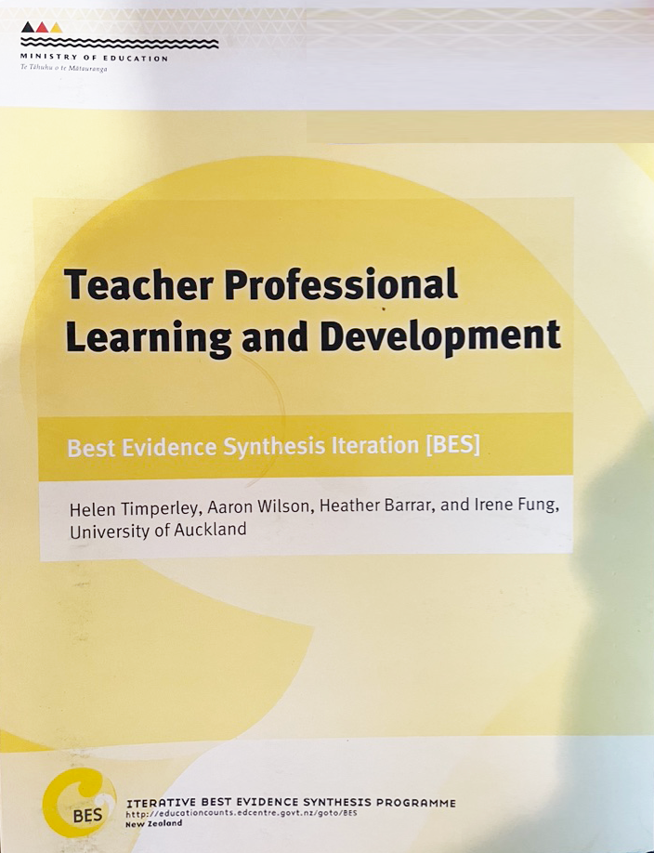
Case Studies in Teacher Professional Learning and Development (Best Evidence Synthesis Iteration (BES)
- Needs analysis approach
- Translating theory into practice
- Developing a research-practice collaboration
- Using assessment to build teaching capacity
- Using evidence of student thinking to inform pedagogy
- Re-culturing and restructuring to solve a problem
- Establishing a culturally responsive pedagogy of relations
- A constructivist, cooperative approach to learning
Facilitation Workshop – 8 April 2022, Ian Stevens
Notes:
Needs analysis approach (Learning Media Writing)
Translating theory into practice (Special needs)
Developing a research-practice collaboration (Decile 1 schools, South Auckland initiative)
Using assessment to build teaching capacity (Assessment for Learning)
Using evidence of student thinking to inform pedagogy (Numeracy Development Project)
Re-culturing and restructuring to solve a problem (Restorative justice initiative)
Establishing a culturally responsive pedagogy of relations (Te Kotahitanga)
A constructivist, cooperative approach to learning (Health PLD initiative)

